Slide 1
Chemistry – Jan 10, 2020
Do Now
Complete the Exploration Activity
P3 Challenge-
How many orbitals are there in
An s subshell?
A p subshell?
A d subshell?
An f subshell?
Objective –
Quantum Numbers
Agenda
Organization of Electrons
Quantum Numbers
Assignment: Quantum Numbers Worksheet

Slide 2
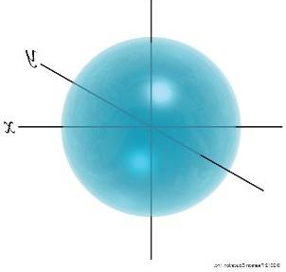
Conclusions from Activity
Orbitals vary in size.
The bigger an orbital, the higher the energy level
Orbitals vary in shape.
The more complicated the shape, the higher the energy level.
Each orbital can hold 2 electrons
Four basic orbital shapes: s spheres, p dumbbells, d 4-leaf clovers, f complicated

Slide 3
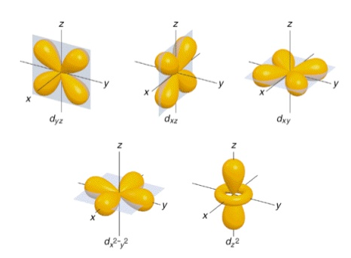
S, P, D, and F Subshells

Slide 4
Quantum Mechanics Atomic Model -
Electrons organized on 4 levels
1) Shells 1, 2, 3, 4, 5, 6, 7
2) Subshells s, p, d, f
3) Orbitals
4) An orbital can hold up to two electrons.
S subshells contain 1 orbital (room for 2 e)
P subshells contain 3 orbitals (6 e)
D subshells contain 5 orbitals (10 e)
F subshells contain 7 orbitals (14 e)
Shell 1 – s (2e)
Shell 2 – s and p (8e)
Shell 3 – s and p and d (18e)
Shell 4 – s and p and d and f (32e)
Shell 5 – s and p and d and f (32e)
Shell 6 – s and p and d (18e)
Shell 7 – s and p (8e)
2 + 8 + 18 + 32 + 32 + 18 + 8 = 118
Structure for all 118 known elements.

Slide 5
Each small box with a 2 represents a single empty orbital that has a capacity of 2 electrons.

Slide 6
Quantum Numbers
A key feature of the mathematics underlying the atomic structure is the use of quantum numbers.
A set of 3 quantum numbers is used to describe an orbital.
A specific electron of the atom must be described by 4 quantum numbers.
The quantum numbers for an electron act like a US address, specifying 4 bits of information to identify: state, city, street and house number.
The wave nature of matter introduces limits on the possible values these quantum numbers can have.

Slide 7
Principal Quantum Number
Principal Quantum number, n, primarily determines the size of the orbital.
The size of the orbital has the largest effect on its energy.
Just like the Bohr model, n defines shells.
The principal QN is indicated by a full-size number.
Allowed values are the integers starting at 1. n= 1, 2, 3, 4….
These values replace the historical K, L, M, N labels.
The n values loosely correspond to the periods 1-7 on the periodic table.

Slide 8
Angular Momentum Quantum Number
Angular Momentum Quantum number, , primarily determines the shape of the orbital.
The more complicated the shape the higher the energy within the shell.
defines a subshell .
Allowed values are the integers starting at 0 up to n-1. = 0, 1, 2, 3 …
The values correspond to the shapes we have already learned and are represented by the letters s, p, d, and f.
=0 means s. = 1 means p. = 2 means d. = 3 means f.
The rule explains why there is an s for all 7 n values, a p for 2-7, a d for 3-6, and an f for 4-5. (We don’t use 7d, 6f, and 7f because their energies are too high to be used by known elements.)

Slide 9
Magnetic Quantum Number
Magnetic Quantum number, $m_{l}$ , primarily determines the orientation of the orbital.
All orbitals within a subshell have the same energy.
$m_{l}$ defines a single orbital.
Allowed values are the integers from – up to .
The number of possible values determine how many orbitals there are in each of the types of subshells.
Specific values for $m_{l}$ are represented with subscripts. E.g. 2p_{x} , 3d_{xy}
These values explain why an s subshell only has one orbital, while p has 3, d has 5 and f has 7.

Slide 10
Spin Quantum Number
Spin Quantum number, m_{s} , primarily determines the spin of an electron.
m_{s} defines a single electron.
Allowed values are the either +1/2 or – 1/2 .
The two possible electrons in an orbital must have different spins.
One will be spin up and one will be spin down.
If only one electron is present it may be either spin up or spin down, equal probability.
Electron spin is represented with arrows or half arrows:

Slide 11
Quantum Numbers Summary
Four Quantum Numbers used to describe the structure. Memory items.
Quantum Number | Name | Allowed Values | Determines | Specifies a | Common labels
n | Principle | 1, 2, 3, 4….. | Size and Energy | Shell | 1,2,3,4… (Period #)
 | Angular Momentum | 0, 1, 2… (only up to n-1) | Shape | Subshell | s, p, d, f
m_{l} | Magnetic |  | Orientation | Orbital | Subscripts (x, y, z, xy, yz etc…
m_{s} | Spin | +½ or -½ | Spin | Electron | Up ↑, Down ↓
$$−ℓ≤m_{l}≤ℓ$$

Slide 12
Exit Slip - Homework
Exit Slip:
How many electrons can an orbital hold?
How many electrons can a p subshell hold?
How many orbitals are there in the n=2 shell?
What’s Due? (Pending assignments to complete.)
Quantum Numbers Worksheet
What’s Next? (How to prepare for the next day)
Read Holt p84 - 88

